Slide 1
Project 2: The Dijkstra’s Algorithm
Kish Choy, Hendy, Linghin

Slide 2
(a) Suppose the input graph G = (V, E) is stored in an adjacency matrix and we use an array for the priority queue. Implement the Dijkstra’s algorithm using this setting and analyze its time complexity with respect to |V| and |E| both theoretically and empirically.

Slide 3
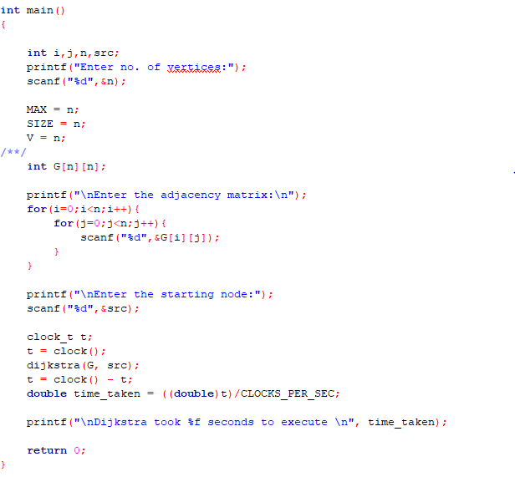
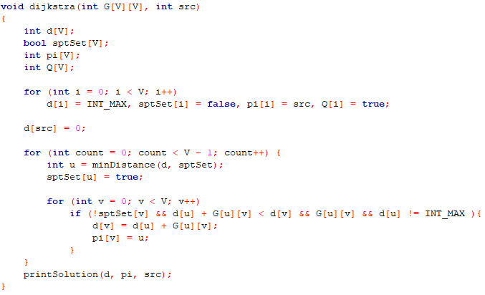
Dijkstra’s with adjacency matrix and use an array for the priority queue

Slide 4
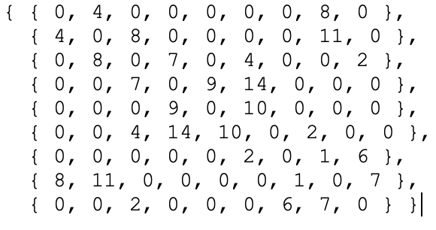

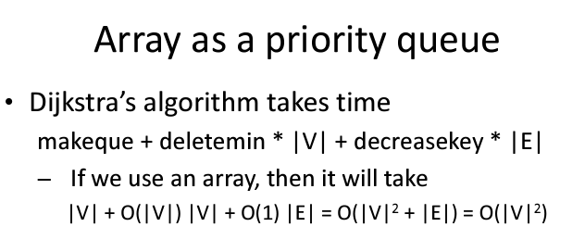
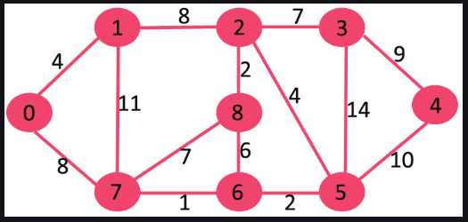
Theoretical Time Complexity
Going through the adjacency matrix, time complexity is O(V^2)
E - # edges
V - # vertices
d - decrease priority
m - extract minimum
O(V^2)
Notes:
Priority queue sorts the queue such that the min is at the front of the queue. Every time a distance gets updated, it needs to sort again.
Math based on: https://en.wikipedia.org/wiki/Dijkstra%27s_algorithm#Running_time

Slide 5
Theoretical Time Complexity
Going through the adjacency matrix, time complexity is O(V^2)
Shifting of Priority Queue time complexity is O(V^2) or better
E - # edges
V - # vertices
d - decrease priority
m - extract minimum
O(V^2)
Notes:
Priority queue sorts the queue such that the min is at the front of the queue. Every time a distance gets updated, it needs to sort again.
(Kish) Sorting of priority queue is worst case V^2 and most cases less so dominant term from walking through adjacency matrix

Slide 6
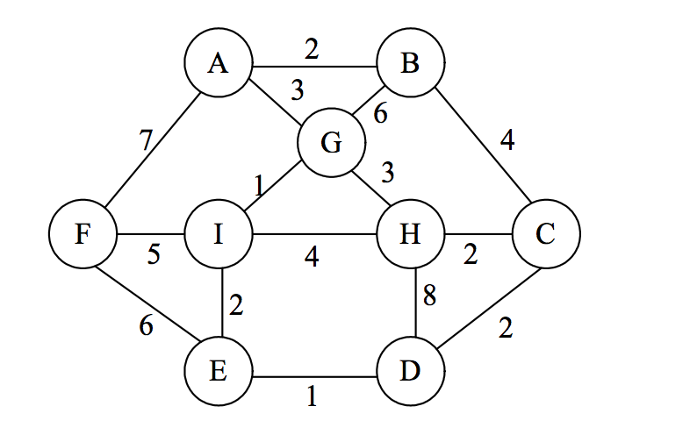
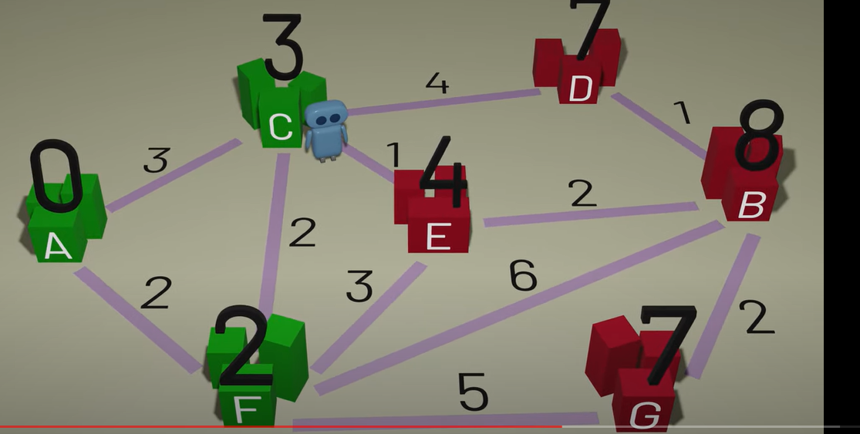
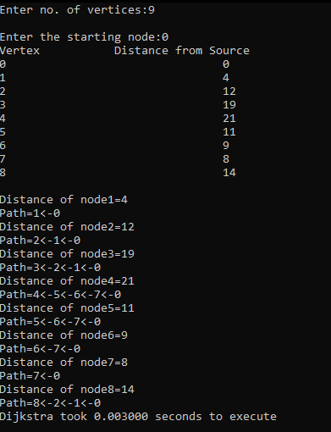
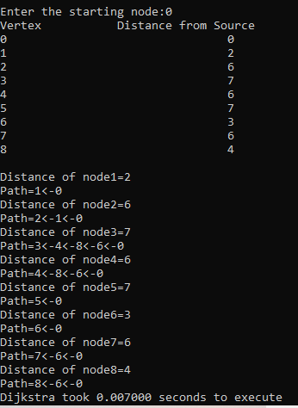
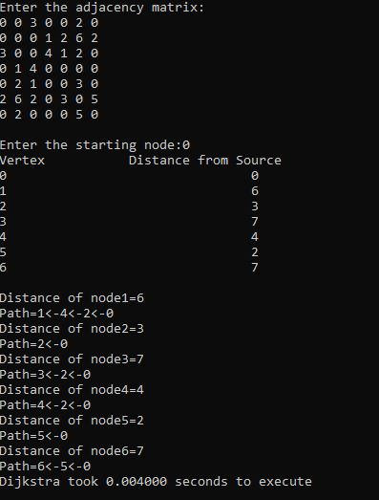

Slide 7
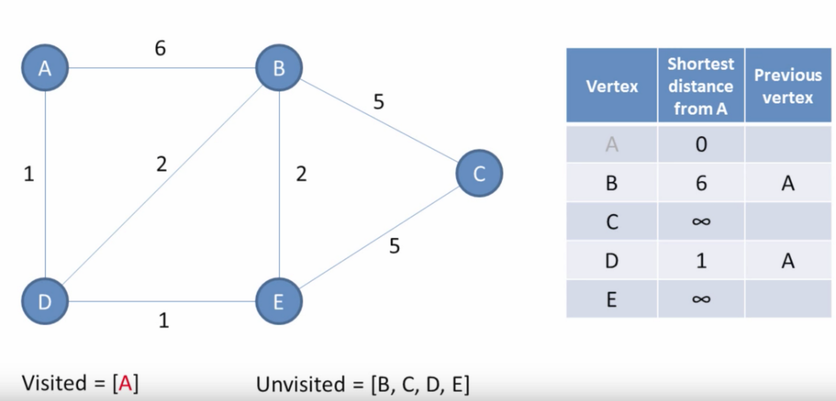
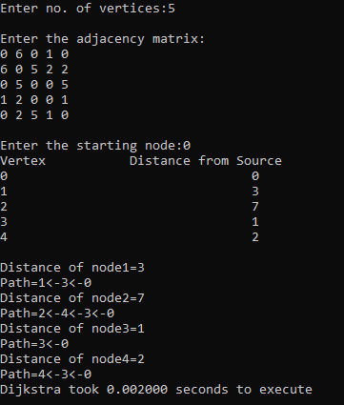

Slide 8
(b) Suppose the input graph G = (V, E) is stored in an array of adjacency lists and we use a minimizing heap for the priority queue. Implement the Dijkstra’s algorithm using this setting and analyze its time complexity with respect to |V| and |E| both theoretically and empirically.

Slide 9
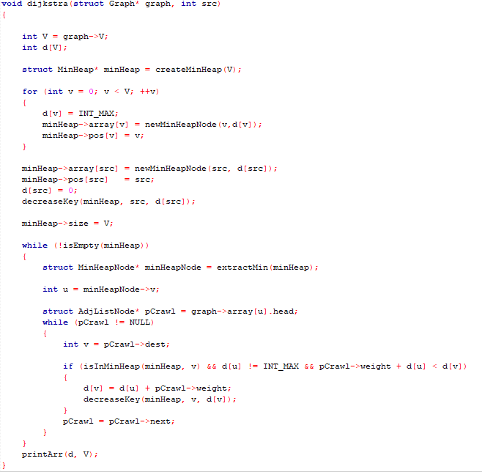
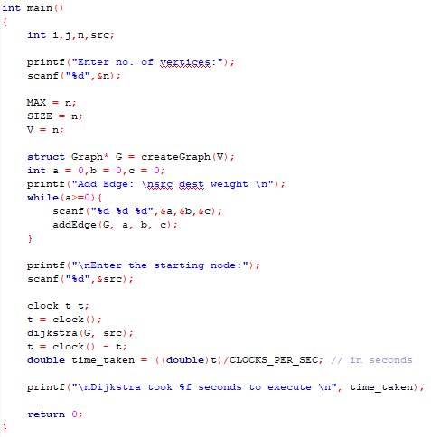
Dijkstra’s with adjacency lists and we use a minimizing heap for the priority queue

Slide 10
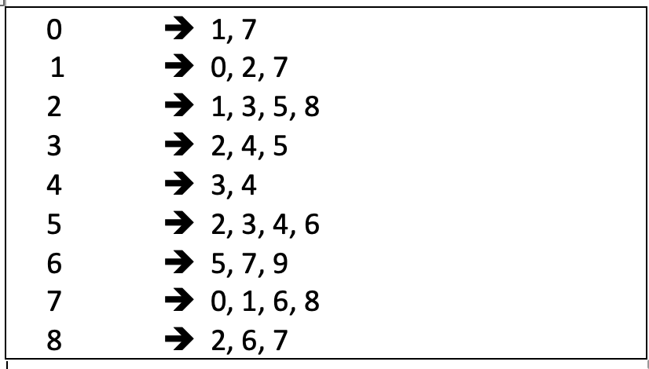

Theoretical Time Complexity
Going through the adjacency list, time complexity is O(V+E)
Each time the a shorter distance is found, it will be updated in the heap and the heap will need to heapify. Time complexity for this will be O(logV)
Overall Time Complexity: O(ElogV)
O(V+E)
E - # edges
V - # vertices
d - decrease priority
m - extract minimum
Notes:
Going through the adjacency list, time complexity is V+E, updating the shorter distance in the heap will take logV
Math Based on: https://en.wikipedia.org/wiki/Dijkstra%27s_algorithm#Running_time
3rd algorithm from top of Running time section

Slide 11
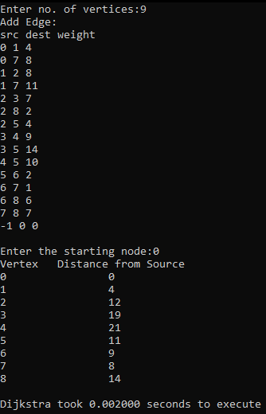
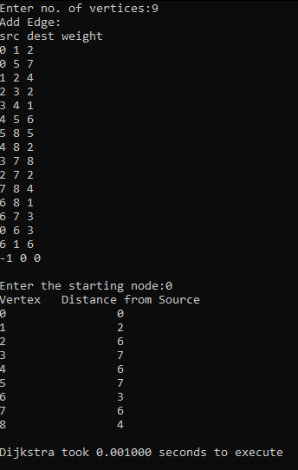
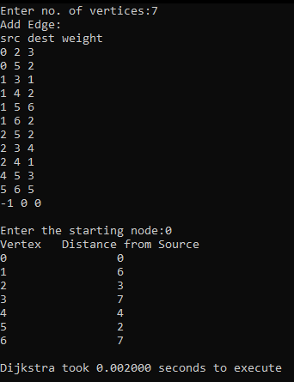

Slide 12
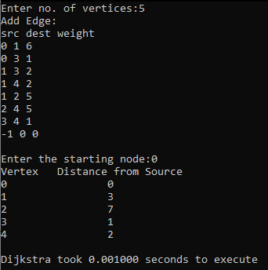

Slide 13
Compare the two implementations in (a) and (b). Discuss which implementation is better and in what circumstances.
Dijkstra’s Algorithm for Adjacency Matrix Representation (In C/C++ with time complexity O(V²)
Dijkstra’s Algorithm for Adjacency List Representation (In C with Time Complexity O(ELogV))

Slide 14
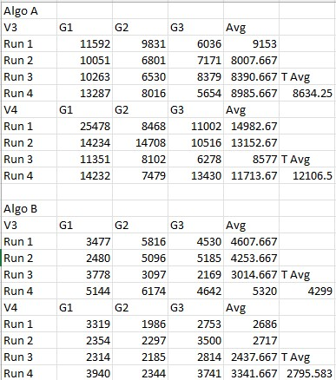
Which implementation is better and in what circumstances

Slide 15
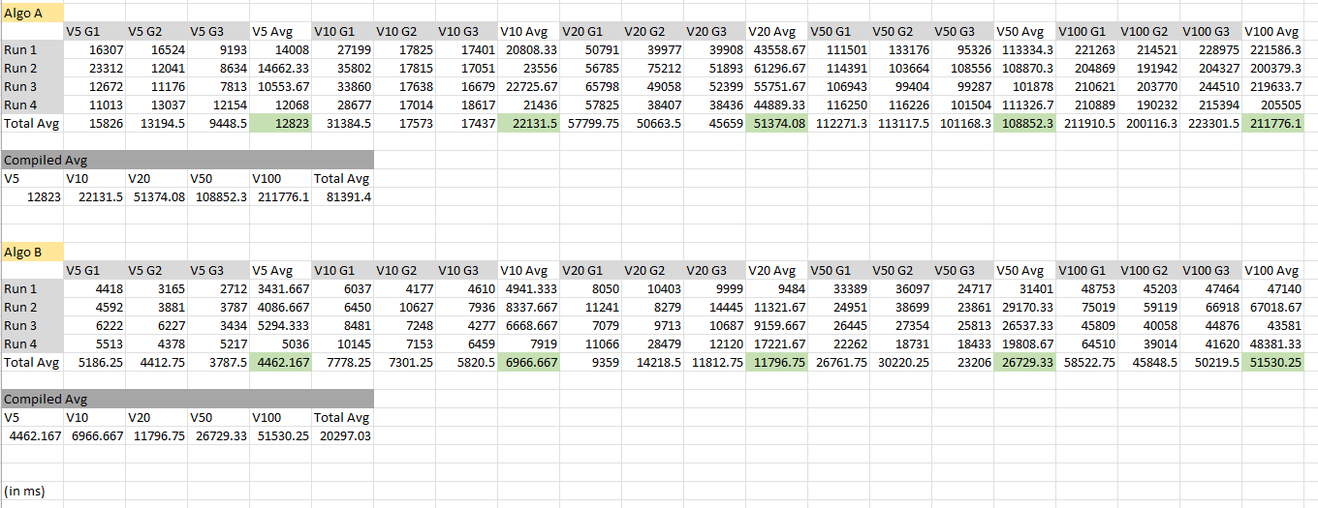
Which implementation is better and in what circumstances

Slide 16
Which implementation is better and in what circumstances
Overall: (b) perform better compare to (a)
Implement (a) Dijkstra’s with adjacency matrix and use an array for the priority queue:
If number of vertex is small and the number of edges is huge
Implement (b) Dijkstra’s with adjacency lists and we use a minimizing heap for the priority queue:
If number of vertex is huge
Unknown graph size

Slide 17
Thank you!

